Slide 1
OBJECT HANDLING CHALLENGE cifar10 | TensorFlow Datasets
MT_The Visionaries_BinteZahra_JohnMata_QuyenD_ITAI_1378
PRESENTATION

Slide 2
INTRODUCTION TO THE CIFAR-10 DATASET
The CIFAR-10 dataset is a widely recognized benchmark in the field of machine learning and computer vision, developed by Alex Krizhevsky, Vinod Nair, and Geoffrey Hinton. It consists of 60,000 32x32 color images evenly categorized into 10 distinct classes, including airplanes, automobiles, birds, cats, deer, dogs, frogs, horses, ships, and trucks. This dataset is primarily utilized for image classification tasks, enabling researchers to train and evaluate the performance of various algorithms and models. Due to its manageable size and comprehensive coverage of different object types, CIFAR-10 serves as an essential resource for developing and testing convolutional neural networks (CNNs). Moreover, its accessibility through popular libraries like TensorFlow and PyTorch makes it a foundational tool for both educational purposes and advanced research.

Slide 3
Dataset Composition
The CIFAR-10 dataset is composed of 60,000 32x32 color images, split into 50,000 training images and 10,000 test images. These images are evenly distributed across 10 different classes: airplane, automobile, bird, cat, deer, dog, frog, horse, ship, and truck. Each image is an RGB image, providing rich color information for each class. The small size of the images makes them ideal for quick experimentation and rapid prototyping of machine learning models. This balanced composition ensures that each class has an equal representation, facilitating unbiased training and evaluation of classification algorithms.
Content:
Total Images: 60,000
Training Set: 50,000 images
Test Set: 10,000 images
Image Size: 32x32 pixels
Color: RGB
Visuals:
Diagram showing the split between training and test sets.
Sample images from the dataset.

Slide 4
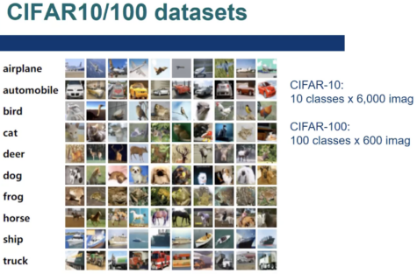
Classes in CIFAR-10
10 different classes:
Airplane,Automobile,Bird, Cat, Deer, Dog, Frog, Horse, Ship, Truck.
Each class contains 6,000 images, ensuring balanced representation. These diverse classes cover a wide range of objects, making CIFAR-10 an ideal benchmark for image classification tasks.

Slide 5
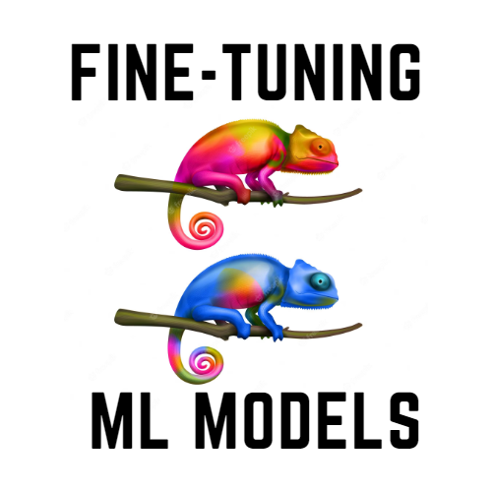
Applications of CIFAR-10
Image Classification:
Used to develop and benchmark image classification algorithms.
Object Detection:
Can be adapted for simple object detection tasks.
Deep Learning Research:
Commonly used for training and testing convolutional neural networks (CNNs).

Slide 6
Accessibility and Tools
Easily Accessible:
Available through popular machine learning libraries.
Libraries:
TensorFlow: tensorflow.keras.datasets.cifar10
PyTorch: torchvision.datasets.CIFAR10
Online Resources:
Official website and documentation.
Tutorials and guides.
Comprehensive documentation and numerous online tutorials support its use, making it beginner-friendly and convenient for researchers. This widespread accessibility ensures that both novice and experienced practitioners can effectively utilize CIFAR-10 for developing and testing their models.

Slide 7
Advantages and Limitations
Advantages:
Small and manageable size for quick experimentation.
Well-studied and benchmarked, with many available models and results.
The dataset covers 10 different classes, representing a wide range of objects, which helps in developing robust image classification models
Available through popular libraries like TensorFlow and PyTorch, CIFAR-10 is easy to access and integrate into various machine learning projects.
Limitations:
Limited resolution (32x32 pixels) may not capture fine details.
Simplicity of classes and images compared to real-world datasets.
Images in CIFAR-10 lack contextual information and background complexity, which can be crucial for more sophisticated image recognition tasks.
The fixed number of classes (10) may not be sufficient for certain applications requiring a more extensive range of categories or more granular classification.

Slide 8
Model Architecture Changes
Try Different Pre-trained Models:
Explore other object detection models (e.g., Faster R-CNN, YOLOv5, EfficientDet) with varying trade-offs between speed and accuracy.
Fine-tuning:
If computationally feasible, fine-tune a pre-trained model on your chosen dataset.
Architecture Modifications:
Research and potentially implement tweaks to the model architecture (changing the number of layers, adjusting hyperparameters).

Slide 9
Research and Choose a Dataset:
Select an appropriate open-source dataset for your object detection project.
Explore the dataset to understand its structure and contents.
Perform Data Cleaning:
Remove irrelevant or low-quality images.
Normalize image sizes.
Address class imbalances if any.
Perform Data Augmentation:
Apply transformations such as rotations, flips, and brightness adjustments to create more diverse training data.
Focus on Relevant Classes:
If the dataset has many classes, consider focusing on a smaller subset relevant to your application.
Dataset Selection and Preparation

Slide 10
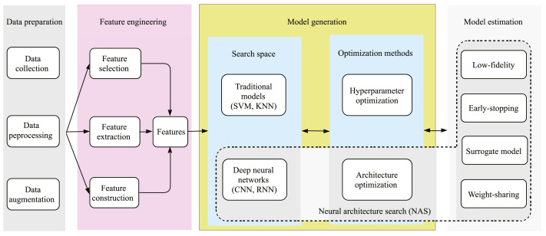

Slide 11
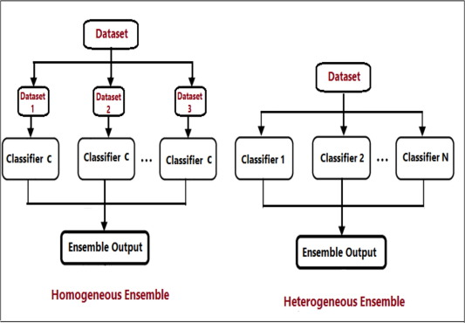
Other Techniques
Ensemble Methods:
Combine predictions from multiple models to improve overall accuracy.
Post-processing:
Apply techniques like non-maximum suppression to refine bounding boxes and reduce false positives.
Model Quantization:
Reduce the model's size and potentially increase inference speed through quantization.
Transfer Learning:
If using a completely different dataset, leverage knowledge gained from pre-training on a larger dataset like COCO.

Slide 12
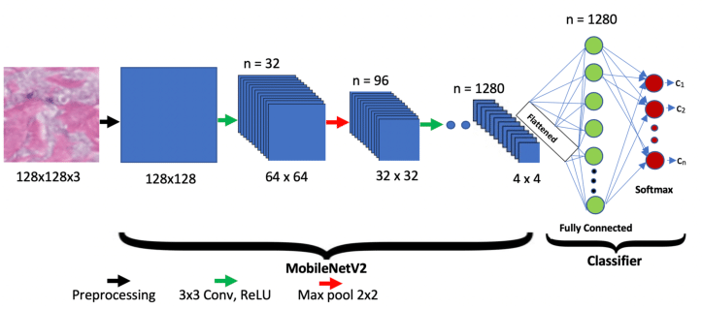
CIFAR-10 Image Classification with MobileNetV2
MobileNetV2:
A lightweight and efficient model designed for mobile and embedded vision applications.
Suitable for training on the CIFAR-10 dataset due to its efficiency.
Model Overview:
Depthwise separable convolutions.
Inverted residuals and linear bottlenecks

Slide 13
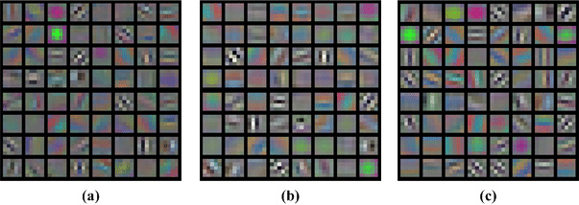
Implementation Steps and Training the model
Implementation
Starting off we would firstly load the cifar-10 dataset
Then followed by loading pre-trained mobilenetv2
Then adding classification head
Training
Consists of compiling the model
Then followed by training the model

Slide 14
Conclusion
CIFAR-10 is a pivotal dataset in the field of machine learning and computer vision, renowned for its balanced composition of 60,000 32x32 color images across 10 distinct classes. It serves as a fundamental benchmark for developing and evaluating image classification algorithms, providing a standard reference for researchers. Its accessibility through major libraries like TensorFlow and PyTorch, combined with extensive documentation and tutorials, makes it an invaluable resource for both beginners and experts. Despite its limitations, such as low resolution and simplicity, CIFAR-10 remains a cornerstone in educational and research settings. Overall, CIFAR-10's ease of use and widespread adoption underscore its enduring significance in advancing the field of computer vision.

Slide 15
Example Code Snippets and References
There are many useful examples of codes that demonstrates these libraries and how to use/load information
https://github.com/kuangliu/pytorch-cifar
https://www.cs.toronto.edu/~kriz/cifar.html
https://www.tensorflow.org/datasets/catalog/cifar10
https://github.com/tensorflow/datasets/blob/master/tensorflow_datasets/image_classification/cifar.py
https://www.geeksforgeeks.org/cifar-10-image-classification-in-tensorflow/

Slide 16
THANK YOU!!!
Quyen Dinh
A big lesson was understanding the ethical issues in AI, like avoiding bias in training data. This project improved my problem-solving skills and my ability to think critically about AI solutions.
Binte Zahra
As an AI associate degree student, this project significantly deepened my understanding of machine learning workflows. Collaborating with my peers on this project was incredibly beneficial; we shared knowledge, debugged issues together, and motivated each other through difficult stages.
John Mata
This project showed the importance of careful dataset selection, thorough data preparation, thoughtful model testing, and effective team collaboration in achieving significant improvements over the baseline model.
MT_The Visionaries_ QuyenD _BinteZahra_JohnMata__ITAI_1378

